Slide 1
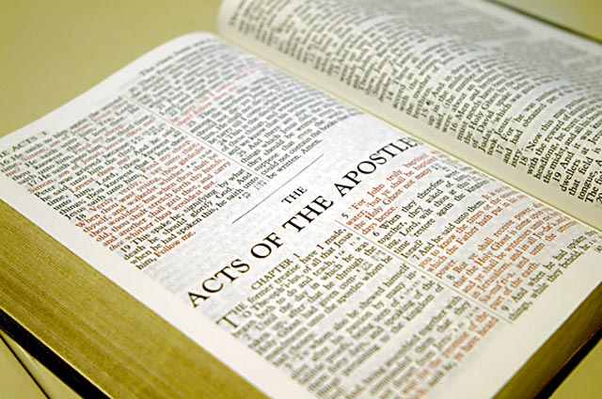
Mairuang ga Kawicham Kenbo
Ndetiuja Tingwang ladkeng kenmatan pad ra chiu mainiu chiumuisui lu ra leng!
Dr. Rick Griffith, Singapore Bible College
BibleStudyDownloads.org

Slide 2
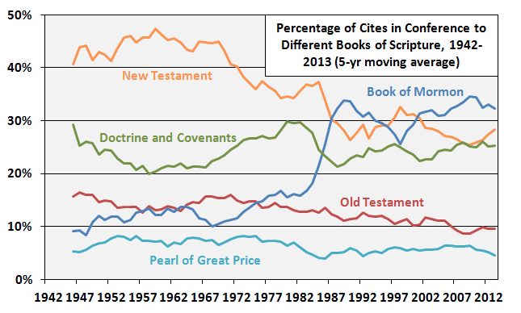
Mormons mainiu kenbo Ariak khuang Mormon kengbo khatdi Kawicham tambo
Khaikhat pabo pabam kadibo wangaruangbo tamtambo ariak dung kawicham, 1942-2013 (5-takum mali nchambo)
Kasan Kawicham
Mormon gu ariak
Agu malumbo & suikhaibo
Kaguang Kawicham
Tingwang ken gu paman kakung bo tathuan
http://zelophehadsdaughters.com/ at 10 July 2014
Notes:
“Finally, I did one more adjustment to account for the norms of how often the different books of scripture are cited in Conference by all speakers during the years each Quorum member served. What I mean here is that at different points in time, different books of scripture were cited more or less by all speakers in Conference. Because members have been in the Quorum for different amounts of time, some of the differences between them can be accounted for by the different norms in Conference at the times they were giving talks.
The biggest shift in the time current Quorum members have served has been an increase in citations of the Book of Mormon. Here’s a graph showing the percentage of all citations of scriptures in Conference that came from each of the five books of scripture since 1942 (as far back as the LDSSCI has Conference talk data).”
Ziff, “Which GAs Prefer Which Books of Scripture?” at http://zelophehadsdaughters.com/ posted 10 July 2014 (accessed 12 Aug 2014)

Slide 3
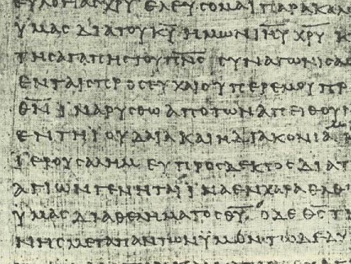
Kawicham din bo ga Para thiu thubo…
9
…sise run na ye nkingmai niu chiulubo niu sisiak lubo Tingwang ladkeng

Slide 4
Chiu ndetiuja Kawicham aliu kenmuijiu kenlu ralo?
9
Phui khe kasia doukalakbo khatdi Kampadlubuibo…

Slide 5
A. Kakeng ga kawicham pabose nsuan gu kawicham din bo ga nia tou makbo
9
Chiu sikania je ncham khai ra!

Slide 6
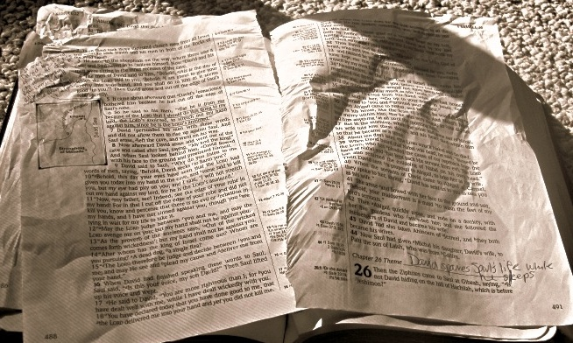
B. Aliu pisikhai mui mak bo pabam se chiu mainiu maniu lanbo aliu nde ga din ken lo
9
Chiu din hou bo ga nang gu ariak bam se din lu sum lo soukum mai chiu tang mui lu mak maileng

Slide 7
C. Aliu ken houmibo mainiu parabo bam phiu bam khabo ting ga
9
Chiu khuanlo nang araik pabo bam loi sai kali lu ken lan makha bo ariak suan

Slide 8
Nang ndetiuja paliu kawicham bam se dou mine paliu gu npoubobung ga?
9

Slide 9
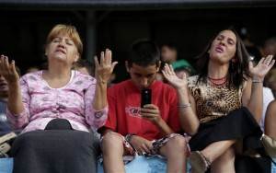
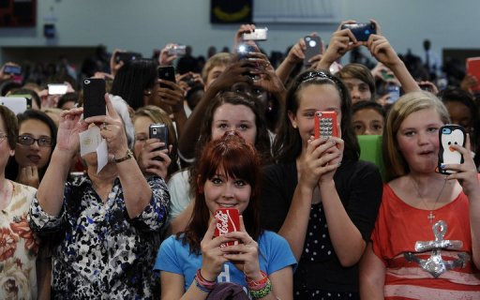
Nang ndetiuja paliu kawicham bam se dou mine paliu gu npoubobung ga?
9
Maniu lo paliu tu nang tu phui lo chiulo

Slide 10
D. Aliu niu si ra pagu racham se sikhai makbo chiu ariakbam tu siraleng (e.g., pimak bo pagu wanjeng ariak para Tienkam 14:21).
9
Chiu pagu racham wanjeng se pisikhai bo wibo ariak pabam nang niu din makha suon ga

Slide 11
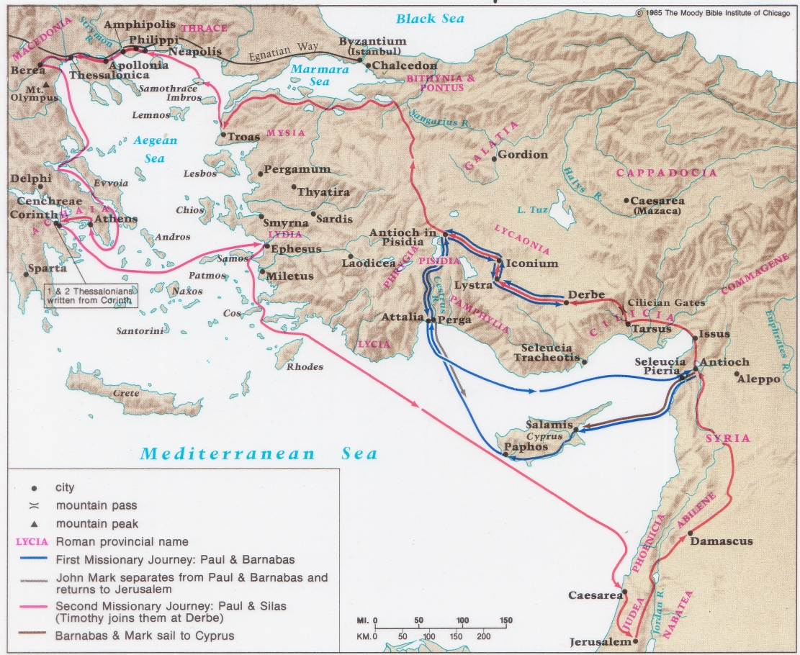
Karaibo Tingwang ladlang tadbo npui
chiu Paul khatdi Barnabas (Tienkam 13–14)

Slide 12
E. Kungbo ladkeng se pakak gara dinmaji makbo ndekam jiulo sai kadin mui makbo jeng gasu-e
9
Chiu thinlo Ringting gu araik khuang lenkhaibo ariak khuang sai lam masan pajan majiraleng (pp. 226-244)

Slide 13
F. Aliu maji kamakbo ladkeng tu din diangbo
9
(Pakhuan “pibo," makge “sileng," Galatiamai gu. 2:20).
“ Sijengniu ringbambo hai I makge, chiudi Khrista niu alungga lungbambo-e. Tuhoi Iniu ringjiu bamboo hai, atu lungsajiu paringting pikhai mibo, Tingwang Nahpiu situ malumbo jengniu I ringjiu bamboo-e” (Galatiamai. 2:20 NIV).

Slide 14
F. Aliu maji kamakbo ladkeng tu din diangbo.
9
(Pakhuan “Eh," makge “pamaga," Tadpadbo. 20:3).
“Atu makbo kaki ratu kahum mane” (Tadpadbo. 20:3 NIV).

Slide 15
F. Aliu maji kamakbo ladkeng tu din diangbo.
9
Chiu kam ali lo nde bo ladkeng tu din diangralo khatdi ken matan padlo ariak khuan se chiu jiu din makeng bo gasu nang mangai makjiu maning tou bam ra.

Slide 16
G. Ariak se paboga kakengna majiobo khuan ga niu kenbo.
9
Chiu tamtam khaibo nang dinbo lakeng khatdi pakhuan tanbo nubo. Namai tu pakhai — paliu ra majaimakbo!

Slide 17
H. Maitu ariak pamuira bo kati kung -e sou kum bo mai “Eh araik pa si ye" chiu maning mimai
9
Chiu chamai 5 ariak pa kasimai khatdi paliu tu kasiam bo katibo ngam kam lo

Slide 18
I. Aliu niu maningbo pawan machang paloi boga sikam mileng maning-e, “Tingwang niu thoidam khai bo thiumilo palad keng pa bo ga."
9
Aliu niu masanbo ladkeng se pamui jiu, tiuja thoidam se dou mibo-e, aliu niu thoidam pimak tadi

Slide 19
Kawicham pabo
9
A. Characham: Chawang thiujiu ngutbo (Mark 11:1-11)
Tacham paoron kalen: Tinggen ga kahumbo (Madukhaibo 4:1-11)
Kachariu: Nkha khai ra kheng khaibo (Tathoilui 70)

Slide 20
Black

Slide 21
Kawicham paorun (Kawibo cham paorunbo thak ajai ali) link at BibleStudyDownloads.org
Paman thiu makjiu haise ngou lu ne!
Notes:
Preaching (pr)
Homiletics

